Slide 1

Computer Networking Devices
Seven Different Networking Components

Slide 2
What is a network device?
Components used to connect computers as well as other electrical devices together in order to share resources such as printers and fax machines.

Slide 3
Devices used in Networking
The different devices or components used in networking include:
Hubs
Switches
Routers
Network bridges
Gateways
Firewalls
Wireless AP (Access Points)

Slide 4
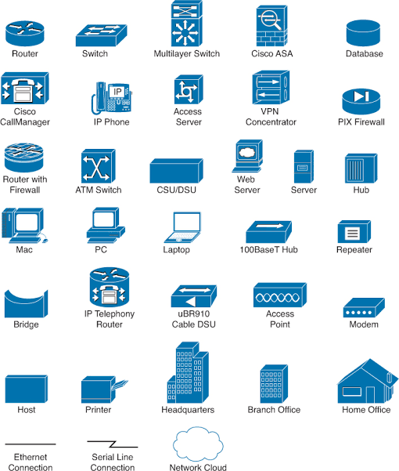

Slide 5
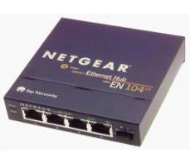
What is a Hub?
A small rectangular box that joins computers together through ports on the back of the hub.
Picture of a 4 – Port Ethernet Hub (below)
J
Ethernet hub – Wikipedia. [online image]. Available en.wikipedia.org/wiki/Ethernet hub

Slide 6
How does a Hub work?
A hub receives data packets and passes on all the Information it receives to all the other computers connected to the hub.
Information is also sent to the computer that sent the information!
Example: if computer 1 wants to communicate with computer 3, the data will be sent to all the computers on the network since hubs do not know the destination of the information it receives.

Slide 7
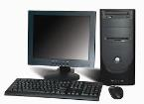
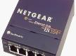

Diagram of a hub network
Main PC
Hub
Ethernet
PC 1
PC 2

Slide 8
Additional Information about Hubs
Most hubs contain 4 ports some have 5 or more ports.
Hubs can be used for a smaller network such as a home network or a small office network.
Hubs are not that expensive most range for less than $30.
Hubs may not be the best option for sophisticated or complex networks.

Slide 9
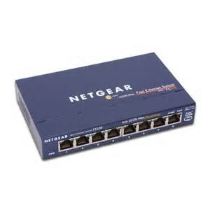
What is a Switch?
Switches look similar to hubs in that they are rectangular in shape. Manageable switches are usually a little bigger than unmanageable switches. A switch also has ports on the back.
Network switch – net gear.[online image]. Available http://www.senasum.blogspot.com, July 9, 2013

Slide 10
How does a Switch work?
Switches work about the same way as hubs. Unlike hubs, switches can identify the destination of a packet.
Switches send information only to the computer that is suppose to receive the information.
Switches can also send and retrieve information at the same time which makes sending information faster to retrieve than hubs.

Slide 11
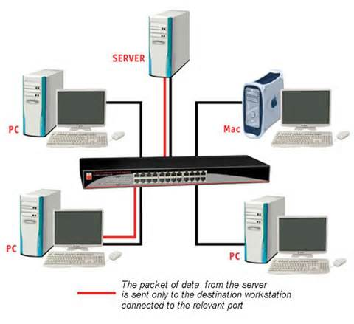
Diagram of a Switch Network
Switch Diagram. LindyConnectionPerfection.[online image]. Available http://www.lindy-international.com, July 9, 2013

Slide 12
Additional Information about Switches
Switches are a better option than hubs for larger networks or home networks with 4 or more connected computers.
Switches can range in price from $30 up to $100 or more depending on if the switch is manageable or unmanageable, usually unmanageable switches are less in price versus managed switches.

Slide 13
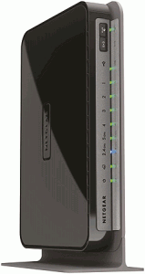
What is a Router?
A specialized computer programmed to interface between different networks.
Netgear-wndr4000-ddwrt-450 – Most Popular VPN Service Providers & DD-WRT Routers. [online image]. www.flashrouters.com, July 12, 2013.

Slide 14
How does a Router work?
A router receives data from the user.
Looks for the remote address of the other computer making routing decisions along the way
Forwards the user data out to a different interface that is closer to the remote computer

Slide 15
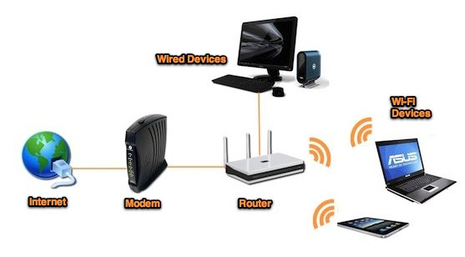
Diagram of a Router

Slide 16
Additional Information about Routers
Routers make sure data sent over the Internet goes where it needs to go and not where it is not needed.
Acts like a traffic controller, working to cut down congestion throughout the network and keeps everything flowing smoothly along the best path.
Routers are the only type of equipment that looks at every single packet passing by on the network.
Home network router including wireless routers can cost anywhere from $40 to $150 or higher.

Slide 17
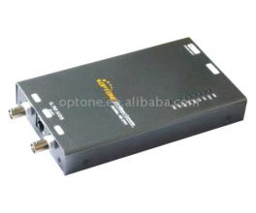
What is a Bridge?
A hardware device used to create a connection between two separate computer networks or to divide one network into two.
Filters data traffic at a network boundary and reduces the amount of traffic on a LAN dividing it into two segments.
I -4E to Ethernet (10/100M) Network Bridge. [online image]. Network Bridge. Available at www.freewtc.com. July 12, 2013.

Slide 18
How does a Bridge work?
Each bridge consist of a MAC address and operates at layer 2 of the OSI model
When a packet is received on the bridge ports the forwarding table including the MAC address is automatically updated to map the source MAC address to the network port from which the packet originated
The gateway then process the received packet according to the packet’s type.

Slide 19
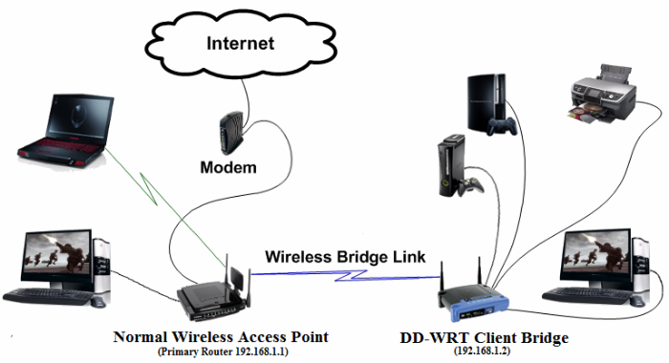
Diagram of a Bridge

Slide 20
Additional Information about Bridges
A bridge examines each message on a LAN and passes the ones known to be within the same LAN.
Computer addresses have no relationship to location in a bridging network.
A bridge is sometimes referred to as a brouter.
Wireless network bridges can costs anywhere from $100 to $1000 or more depending on the type of bridge purchased.

Slide 21
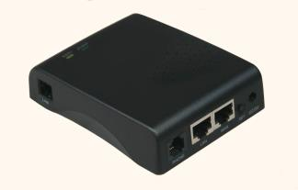
What is a Gateway?
A communication device that provides a remote network with connectivity to the host network.
Gateway Network Communications [online image]. Available www.hiwtc.com

Slide 22
How a Gateway Works
The gateway node acts like a proxy server and firewall
The gateway uses forwarding tables to determine where packet are to be sent

Slide 23
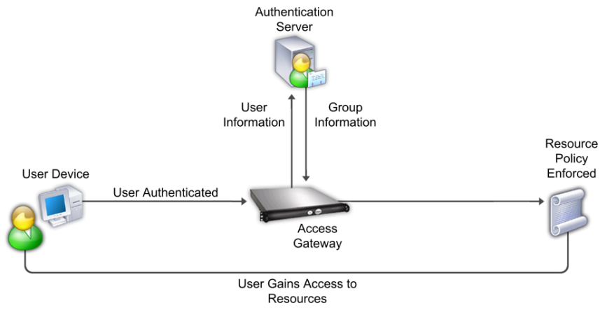
Gateway Diagram

Slide 24
Additional Information about Gateways
On the Internet a node or stopping point can be a gateway.
The computers controlling traffic within a network are gateway nodes.
A gateway is also associated with a router.

Slide 25
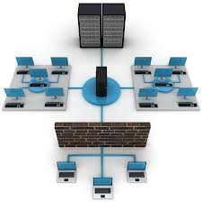
What is a Firewall?
Hardware or software device that protects a computer network from unauthorized access.
Firewall Sling Secure Smartphone. [online image]. Available www.slingsecure.com

Slide 26
How a Firewall works
Firewalls filters the information coming through the Internet connection into a user private network.
To control traffic in and out of the network firewalls one or more of the three methods are used including:
Packet filtering
Proxy service
Stateful inspection

Slide 27
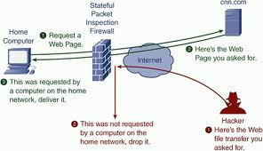
Diagram of Firewall

Slide 28
Additional Information about Firewalls
Most home network routers have built in firewall.
The term “firewall” originated from firefighting, where a firewall is a barrier established to prevent the spread of a fire.
A firewall works with the proxy server making request on behalf of workstation users.
There are a number of features firewalls can include from logging and reporting to setting alarms of an attack.
Costs for host based firewalls usually costs around $100 or less. Some may costs more depending on different things such as features included or if its an enterprise based system.

Slide 29
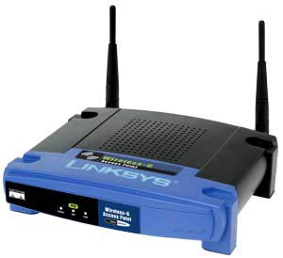
What is a Wireless Access Point?
A small hardware device featuring built-in network adapter, antenna, and radio signals.
Configured nodes on a WLAN.
Wireless Access Points, Page 2. [online image]. Available compnetworking.about.com

Slide 30
How a Wireless Access Point works?
Operates using radio frequency technology
Broadcast wireless signals computers can detect and use
A wireless network adapter is implemented while using a wireless access point, most computers today already have network adapters built into the computer.

Slide 31
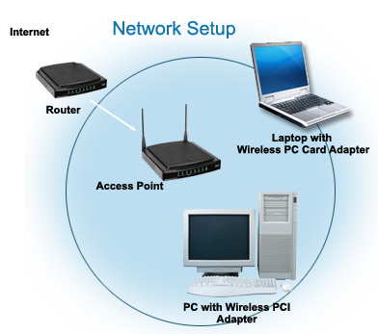
Diagram of Wireless Access Point
RxNT – The eprescribing System. [online image]. Available www.rxnt.com

Slide 32
Additional Information about Access Points
The access point usually connects to the router
A hotspot is a application wireless users can connect to the Internet.
Aps are used throughout a home network, usually through only one AP.
Wireless access points can cost anywhere from $30 and up depending on the type purchased.

Slide 33
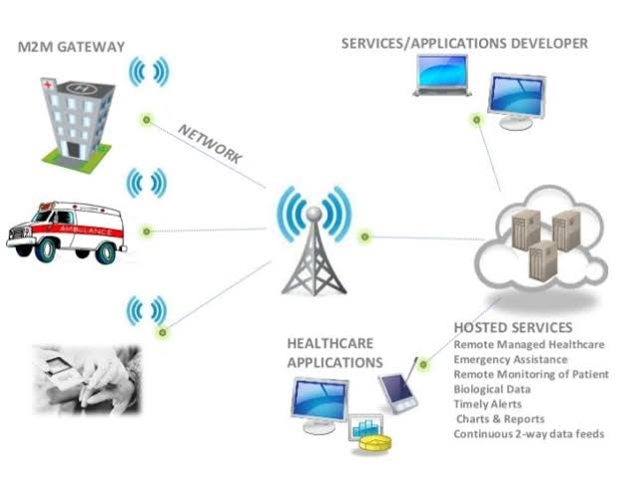
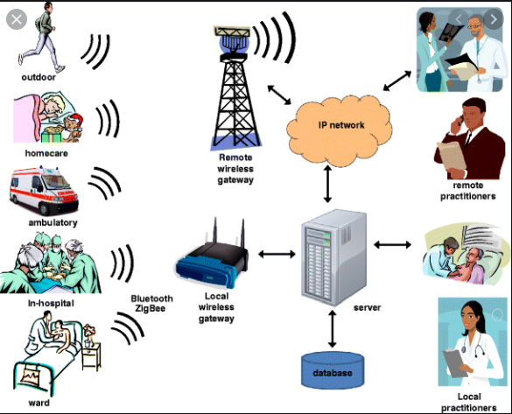

Slide 34
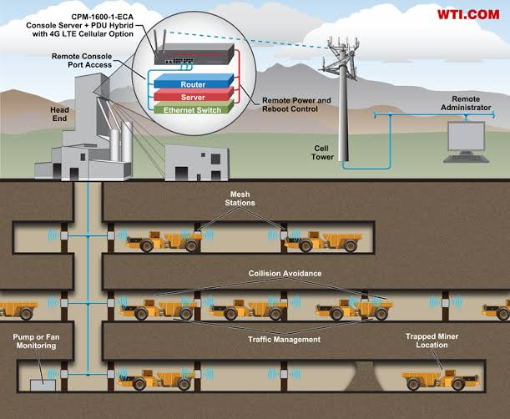
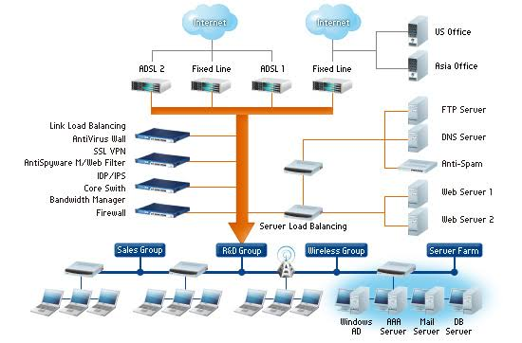

Slide 35
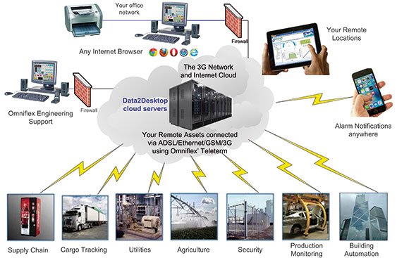

Slide 36
Websites Used
Searchsecurity.techtarget.com/definition
About.com
Howstuffworks.com
Windows.microsoft.com

